Slide 1
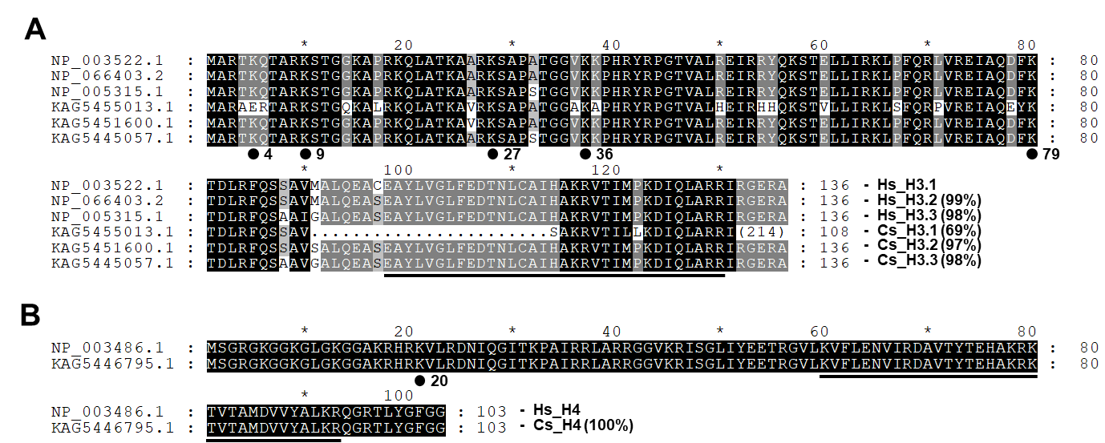
Supplementary Fig. S1. Comparison of primary structures of histones H3 (panel A) and H4 (panel B) between Clonorchis sinensis and human. The amino acid (aa) sequences of histone H3 and H4 paralogs were retrieved from the GenBank databases and were aligned against one another for comparison of their primary structures. The degrees of the aa conservations are highlighted using different shades of grey, and gaps represented by dots were introduced in the alignment to increase the similarity values. Solid lines under the alignments represent the histone fold domains conserved in eukaryotic histones H3 and H4 (Postberg et al., BMC Evolutionary Biology 2010, 10:259). The Lys residues majorly targeted by histone lysine methyltransferases for methylation are indicated by solid dots. The percentage values in the parentheses following proteins names are similarity values calculated against Hs_H3.1 or Hs_H4.
Notes:
Underlined: histone domain fold domains conserved in several eukaryotic histone H3 and H4 as well as archaeal histones (Postberg et al., The evo,utionary history of histone H3 suggests a deep eukaryotic root of chromatic modifying mechanisms. BMC evolutionary biology 2010, 10:259.)
Numerals in the end of Cs_H3.1: the number of amino acids in the C-terminal region of Cs_H3.1

