Slide 1
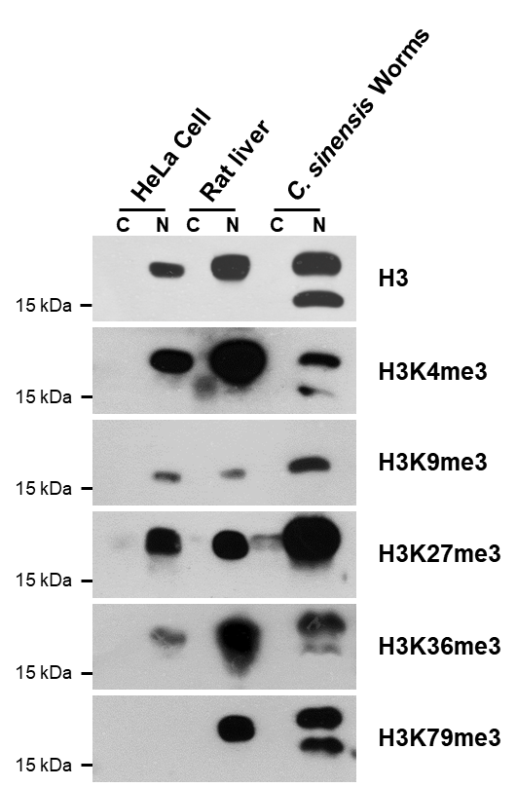
Supplementary Fig. S2. Detection of methylated histone derivatives in the cellular protein extracts of Clonorchis sinensis. The cytosolic (C) and nuclear (N) extracts of C. sinensis adults were reacted with antibodies specific to the histone derivatives after being resolved via 15.0% SDS-PAGE. The protein extracts were similarly prepared from human HeLa cells and rat liver parenchyma and used in the experiment.

